Slide 1
Fifa 19 Data Analysis Project
Akbar Moledina
Notes:
Interested in football at all?
You’re welcome to ask questions at any time.

Slide 2
Summary of the Data
FIFA 19 complete player dataset - obtained from kaggle.com
18207 rows and 89 columns
We are only interested in the top 25 rows ordered by the Overall column, which will give us the top 25 players in Fifa 19
36 of the 89 columns are used in the analysis
All of the irrelevant data was removed at the start of the project
Notes:
Original dataset contained all the players in the game, and contained several rows and columns that we weren’t particularly interested in.
Out of 18k players, we only wanted the top 25 (sorted by Overall Rating). The other rows were removed.
Some columns also features data we weren’t interested in - such as Club, Nationality, Value and Wages.

Slide 3
Purpose
It was considered optimal to try to answer the main question I had about the data in a clean and straightforward manner.
This project examined and analysed the 25 highest rated players on Fifa 19. It attempted to look at which attributes made these players some of the best in their respective positions.
Notes:
Sample size is only 25 because to focus purely on the elite players

Slide 4
Expected Results
Goalkeepers - proficient at the five goalkeeping attributes
Central Defenders - physically strong, good in the air and have strong technical defensive attributes
Midfielders - the most technical set of players; blend of attacking and defensive stats
Wide players - very fast, good at crossing, dribbling and ball control
Strikers - high finishing, composure and positioning stats
The peak age to be around 27
Notes:
GK - Reflexes, Handling, Diving, Positioning and Kicking. Also Reactions.
CB - Such as tackling, marking and interceptions.
CM - Will have very different stats depending on their main role, hope to find out core stats that are vital to all midfielders. These are likely to be Passing, Composure and Vision - stats that help create goals and dictate the game.
WM - Wide players are expected to be fast and able to get past players with the ball.
ST - Needs to be very good at getting into the right positions and scoring goals.
27 years old seems like a good point where players have developed technical and mental attributes, but they are still in top physical condition.

Slide 5
Analysis Process
Python was chosen as the main tool for the process
The data was examined and information that was not needed was removed
Looked at Overall Rating and Age for the top 25 players
Visualised the spread of Overall and Age
Sorted the players into positional categories
Additional data was removed, specific to each position category
Analysis of attributes was performed on these groups of players
Visualizations were produced when needed
Answers and conclusions were drawn, to address the project’s purpose
Notes:
General information about the analysis process.
Python because: comfortable with it, capable of doing what I needed, a skills to develop further.
Club, Nationality, Image links, etc were removed, only really interested in attributes.
Overall Rating and Age are relevant to all players. A simple visualization was produced using PyPlot.
Players were sorted into groups by main playing position.
In a category, if no players had a rating of above 85 in a particular attribute column, that column was removed for that group.
Analysed and visualised the data.
Discussed the things I expected, and things that I was surprised about + any reflections I had

Slide 6
Overall Rating and Age
 | Overall Rating | Age
Min | 89 | 24
Max | 94 | 33
Mean | 90.2 | 28.84
Median | 90.0 | 29.0
Notes:
All the attribute related stats are out of a maximum of 99 - including the Overall Rating stat here.
For the Overall Rating, it’s important to note that the mean and median values are much closer to the minimum.
Meanwhile for age, it is closer to the middle. (Midpoint is 28.5)

Slide 7
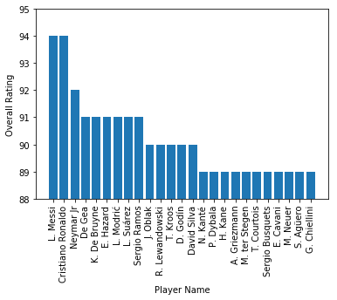
Players by Overall Rating
Notes:
Visualisation of players by Overall.
We can see why the mean and median were much closer to the minimum overall.
Messi and Ronaldo much better than the others.
Most players between 89 and 91, with only 3 players between 92 and 94.

Slide 8
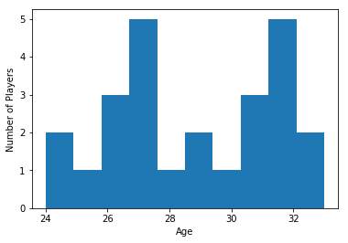
Age Distribution
There appears to be a bimodal distribution, one peak at 27 and another at 32
Relatively small sample size spread across 10 bins in the histogram
Players aged 27 appear to generally be more reliant on pace, such as Griezmann and Hazard
32 year old players seem to either be defensive players or very technical players - like Ramos, Godin and Modrić
Assuming that players in their peak are more likely to be in the top 25 players, the histogram gives some insight on the peak age for certain types of football players
Notes:
Age distribution histogram.
Small sample size with lots of bins in the histogram means findings might not be totally accurate - but still gives us a rough idea.
With more time, a full attribute analysis would’ve been done for players near the peaks. For now, used football knowledge to come to an well educated guess.
We assume that players are more likely to be near their peak in order to be in the top 25 players. This may not be true for players that are much better than the other players in the sample - such as Messi and Ronaldo.

Slide 9
Sorting Players by Position
Goalkeepers
De Gea, Oblak, ter Stegen, Courtois, Neuer
Central Defenders
Ramos, Godin, Chiellini
Full Backs
N/A
Central Midfielders
De Bruyne, Modrić, Kroos, Silva, Kanté, Griezmann, Busquets
Wingers
Messi, Neymar, Hazard, Dybala
Strikers
Ronaldo, Suárez, Lewandowski, Kane, Cavani, Agüero
Notes:
Pick their favourite player from the list.
No full backs, irrelevant category.
Central midfielders include both defensive and attacking midfielders.
Griezmann could be in CM, Winger or Striker. He's listed as CAM in the dataset so grouped with CM.
It might’ve been a good idea to separate CMs into multiple categories.

Slide 10
Removing Irrelevant Data by Position
For each position category, unimportant attributes for that particular position were removed
This was done by removing all columns that contained no attributes rated above 85 for a particular position
As a result, only columns that contain one or more values above 85 are retained for further analysis
This allowed focus on attributes that the players were really good at
Notes:
All the players are in groups, more data can be removed.
e.g. not interested in the outfield attributes of a goalkeeper.
If at least one player from a set has a particular stat that is above 85, then it is worth looking at. If that’s not the case the we aren’t particularly interested in the attribute.

Slide 11
Positional Analysis
Notes:
Main analysis part of the presentation.
There will be visualizations - that I made in Tableau - to look at any stats that are particularly high or low for each player
This is followed by a table where we look at the mean values of every attribute. Which will help us decide which stats are the most important.
We will do this for every positional group that we are analysing.

Slide 12
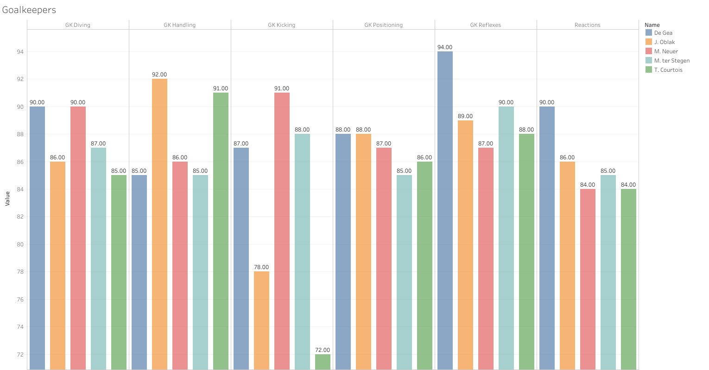
Notes:
Grouped by attribute and colour coded by player.
GK Reflexes stats are consistently very high (De Gea’s stat is exceptionally high).
GK Kicking has the widest range, and contains the lowest and 2nd lowest value. It’s a nice stat to have for GKs but not vital.
If a GK had 72 reflexes for example (like Courtois’ kicking), then they probably wouldn’t be top 25

Slide 13
Average Stats for Goalkeepers
GK Reflexes | 89.6
GK Handling | 87.8
GK Diving | 87.6
GK Positioning | 86.8
Reactions | 85.8
GK Kicking | 83.2
Notes:
Ordered by the mean value
Top goalkeepers are more likely to have very high reflexes.
All these stats are important, however, reflexes are probably the most important and kicking the least.

Slide 14
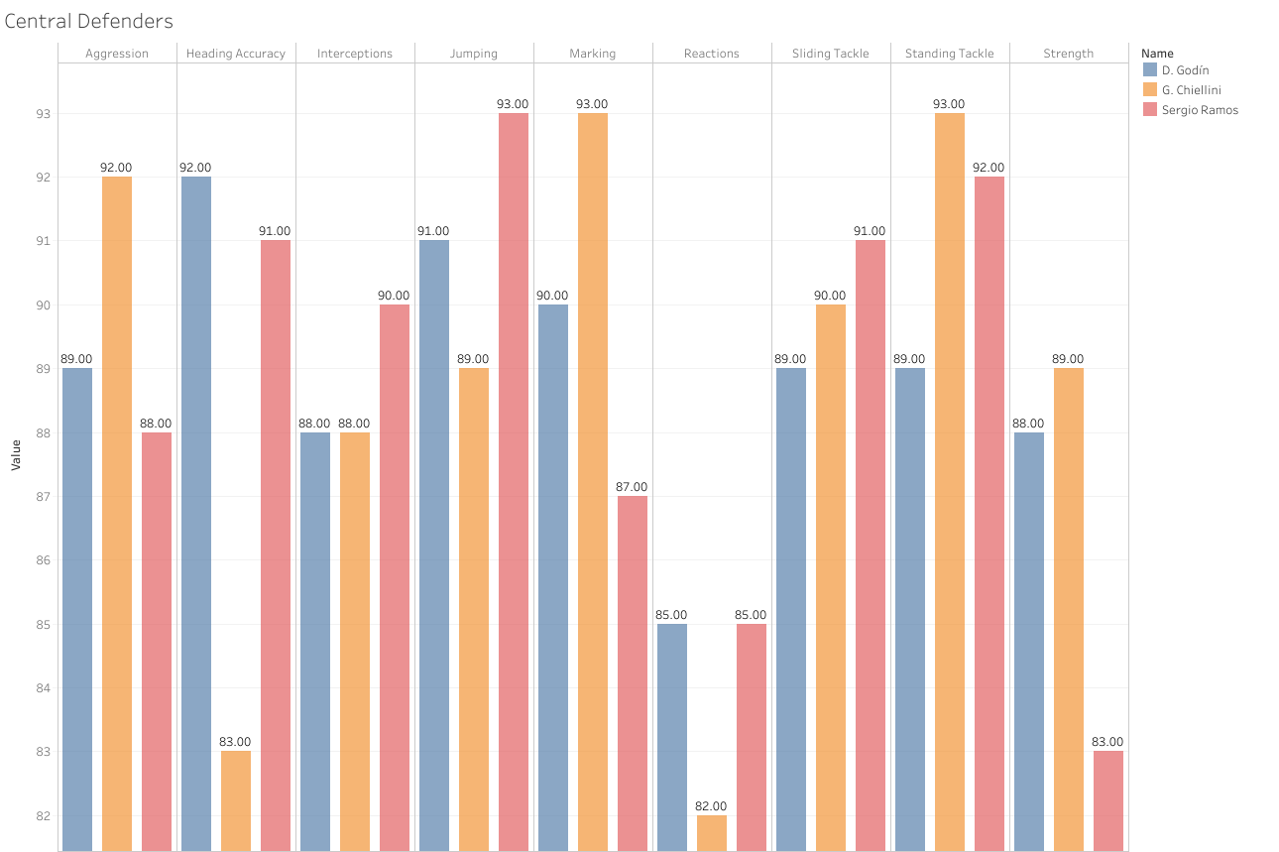
Notes:
Reactions are consistently fairly low. (35 stats in total most were dropped though)
Standing tackle and jumping are the most vital.
All stats are important, Reactions and Strength less important.

Slide 15
Average Stats for Central Defenders
Standing Tackle | 91.3
Jumping | 91.0
Marking | 90.0
Sliding Tackle | 90.0
Aggression | 89.7
Interceptions | 88.7
Heading Accuracy | 88.7
Strength | 86.7
Reactions | 84.0
Notes:
Higher on the table = more likely to be key stats
Jumping higher than expected, but makes sense

Slide 16
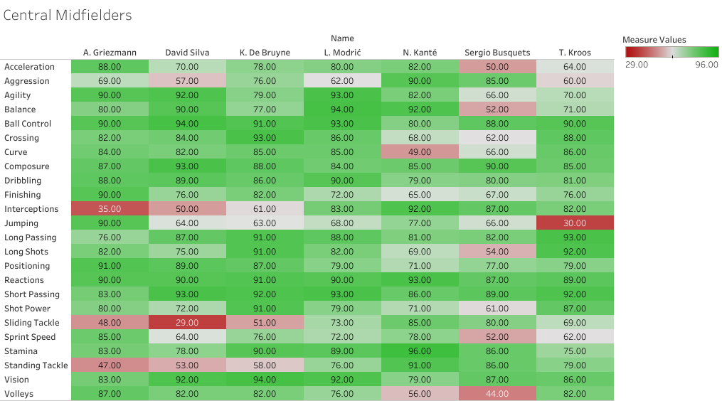
Notes:
Graph is too big to reliably extract information.
Easier to see variances on the colour coded table
Jumping doesn’t matter too much. Griezmann is probably only good at it because he’s a very explosive player
Interceptions and Standing tackle are important for CDMs, and more important than sliding tackle.
Reactions, Short Passing, Ball Control, Vision and Composure for all CMs

Slide 17
Average Stats for Central Midfielders
Reactions | 90.0 | Agility | 81.7 | Aggression | 71.3
Short Pass | 89.7 | Crossing | 80.4 | Marking | 71.1
Ball Control | 89.4 | Balance | 79.4 | Interceptions | 70.0
Vision | 87.6 | Long Shots | 77.9 | Stand Tackle | 70.0
Composure | 87.4 | Shot Power | 77.3 | SprintSpeed | 69.9
Long Pass | 85.4 | Curve | 76.7 | Jumping | 65.4
Stamina | 85.3 | Finishing | 75.4 | Slide Tackle | 62.1
Dribbling | 84.7 | Acceleration | 73.1 | - | -
Positioning | 81.9 | Volleys | 72.7 | - | -
Notes:
Table of averages gives a lot of info on core stats
Reactions, Short Passing, Ball Control, Vision and Composure are core attributes for midfielders of any type.
Physical attributes, aside from Stamina, in general appear to be less important.
Technical attributes are key.

Slide 18
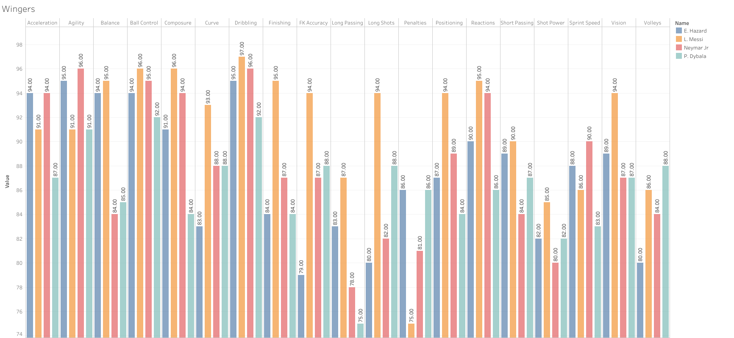
Notes:
Dybala is noticeably less proficient than the other 3.
Dribbling and ball control are key technical skills.
Agility and acceleration are key physical skills.
All of these are vital when taking on defenders.

Slide 19
Average Stats for Wingers
Dribbling | 95.0 | Finishing | 87.5
Ball Control | 94.2 | Short Passing | 87.5
Agility | 93.2 | FK Accuracy | 87.0
Acceleration | 91.5 | Sprint Speed | 86.8
Composure | 91.2 | Long Shots | 86.0
Reactions | 91.2 | Volleys | 84.5
Balance | 89.5 | Shot Power | 82.2
Vision | 89.2 | Penalties | 82.0
Positioning | 88.5 | Long Passing | 80.8
Curve | 88.0 | - | -
Notes:
Surprising that Crossing did not make it onto the list.
Probably because all the players featured are Inside Forwards rather than Traditional Wingers.
Balance is high on average, but a couple players had low balance whilst other had very high
Stats are mainly geared towards dribbling past players.
Finishing, composure and reactions are very high too, suggesting that modern wide players are expected to score goals whilst under pressure.

Slide 20
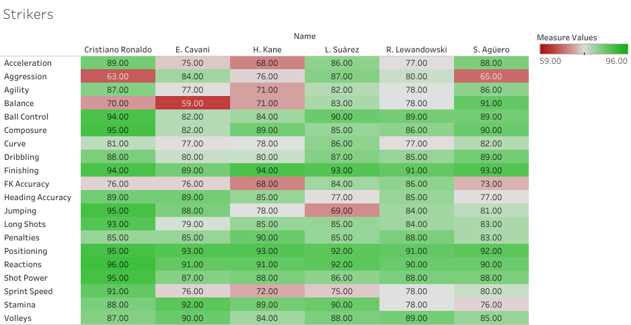
Notes:
Cristiano has really well rounded stats. Balance doesn’t seem as important as the others.
Would like to investigate the relationship between Aggression and Work Rate.
Some strikers are good at jumping and heading. Probably depends on their body type.

Slide 21
Average Stats for Strikers
Positioning | 92.7 | Long Shots | 84.8
Finishing | 92.3 | Heading Accuracy | 83.7
Reactions | 91.7 | Jumping | 82.5
Shot Power | 88.7 | Acceleration | 80.5
Ball Control | 88.0 | Curve | 80.2
Composure | 87.8 | Agility | 80.2
Volleys | 87.2 | Sprint Speed | 78.7
Penalties | 86.0 | FK Accuracy | 77.2
Stamina | 85.5 | Aggression | 75.8
Dribbling | 84.8 | Balance | 75.3
Notes:
All about getting into the right positions and scoring goals.
Dribbling is surprisingly high (almost same as wingers), would’ve expected the average to be around 90 (below finishing).

Slide 22
Summary
Messi and Ronaldo have a much higher Overall Rating than the average
The mean age was 28.84
General peak age for pace reliant players of this calibre was around 27
For more technical or defensive players it was found to be around 32
Vital stats by position:
Goalkeepers - Reflexes, Handling and Diving
Central Defenders - Standing Tackle, Jumping, Marking and Sliding Tackle
Central Midfielders - Reactions, Short Pass, Ball Control, Vision and Composure
Wingers - Dribbling, Ball Control, Agility and Reactions
Strikers - Dribbling, Finishing, Positioning and Reactions
Notes:
Messi and Ronaldo skew the the mean slightly, since they are significantly better than everyone else in the dataset.
Multiple peak ages for different players.
The majority of stats per position were roughly what we expected.

Slide 23
Conclusion
There were a few surprising things that were found out while carrying out analysis on this set of data.
It was expected that players peak age would be late 20s, however, the histogram showed a bimodal distribution
Reactions was a key stat for almost all positions
Crossing was thought to be vital for wingers
Notes:
Bimodal distribution in the age distribution histogram not considered. First peak at 27 was expected. But a second peak was much later at 32 was not.
Reactions were vital for more attacking players, but still important all round. Even for defenders and goalkeepers.
Crossing was less important than expected since there were no Traditional Wingers, only wide players who play the Inside Forward role.

Slide 24
Reflection
If I was to spend more time on the project I’d:
Compare promising young players to the top 25
Analyse Attributes by Age further
Look at how Aggression is related to Work Rate, and which positions require high Work Rates
Have multiple categories for different types of Central Midfielders
Some of the difficulties I had were:
Keeping visualizations simple enough for presentation slides
Some of the features that I needed to use from Python’s data libraries were new to me
Not hugely experienced with writing reports or making presentations
Notes:
Stats by Age to see when stats peak. Could look at historical data.
Central midfielders could’ve been split into CDMs and CAMs.
See what stats young players lack in. Would help influence what they train.
Not experienced with Tableau.
Data libraries such as PyPlot’s histograms and customising the number of bins - needed to google
Wrote reports and made presentations in university, and not so much since

